Slide 1
JAVA EXPRESSIONS, EXPRESSION EVALUATION, PRIORITY AND ASSOCIATIVITY, TYPES OF OPERATORS AND EXAMPLES
-Pranali Chougule

Slide 2
JAVA EXPRESSIONS
In Java, an expression is a combination of values, variables, operators, and method invocations that are evaluated to produce a single value.
An expression can be a single value or a combination of values that produce a result.
TYPES OF EXPRESSIONS:
1. Arithmetic Expressions -
These involve arithmetic operators to perform mathematical calculations.
Example: int result = 10 + 5;
2. Relational Expressions -
It is Used to compare two values and return a boolean result.
Operators: >, <, >=, <=, ==, !=
Example: boolean isGreater = 10 > 5;

Slide 3
3. Logical Expressions-
It is Used to combine or invert boolean expressions.
Operators: && (AND), || (OR), ! (NOT)
Example: boolean result = (10 > 5) && (5 < 8);
4. Assignment Expressions-
Assign values to variables.
Example: int x = 5;
5. Unary Expressions-
It Involve only one operand, often to increment or negate a value.
Example: int x = 10;
x++;
6. Conditional (Ternary) Expressions-
A concise way to express conditional statements.
Syntax: condition ? valueIfTrue : valueIfFalse
Example: int a = 10, b = 20;
int max = (a > b) ? a : b;

Slide 4
EXPRESSION EVALUATION
Expression Evaluation refers to the process of evaluating or computing the value of an expression, which consists of variables, constants, and operators.
In programming languages like Java, expressions can involve arithmetic, relational, logical, or bitwise operations, and are evaluated based on certain rules.
Expression Evaluation Process
Evaluate Sub-Expressions: Identify and evaluate smaller sub-expressions first, using parentheses if needed.
Apply Operator Precedence and Associativity: Use precedence and associativity rules to decide the order of operations.
Perform Type Conversion (if required): Promote smaller types to larger types if operands are of different types.
Compute the Final Value: Evaluate the expression to produce the final result.

Slide 5
In programming, infix, postfix, and prefix notations refer to the different ways of writing expressions that involve operators and operands.
These notations are primarily used to define the order in which operations are performed in an expression.
1. Infix Notation:
In infix notation, the operator is placed between the operands. This is the most common notation used in arithmetic and programming.
2. Prefix Notation (Polish Notation)
In prefix notation, also called Polish notation, the operator is placed before its operands. It does not require parentheses to indicate precedence, as the position of the operator itself determines the order of operations.
3. Postfix Notation (Reverse Polish Notation, RPN)
In postfix notation, also known as Reverse Polish Notation (RPN), the operator is placed after its operands. Like prefix notation, postfix does not require parentheses to indicate order of operations, as the position of the operators dictates the evaluation order.
Example:
Infix expression: 2 + 3
Prefix notation: + 2 3
Postfix notation: 2 3 +

Slide 6
PRIORITY AND ASSOCIATIVITY
In Java, operator priority and associativity determine how expressions with multiple operators are evaluated.
Precedence/ priority defines the order in which different operators are applied
Associativity defines the direction (left-to-right or right-to-left) in which operators of the same precedence level are evaluated.
1. Operator Precedence
Operators with higher precedence/ priority are evaluated before those with lower precedence.
This means that in expressions with multiple operators, those with higher precedence are executed first, even if they appear later in the expression.

Slide 7
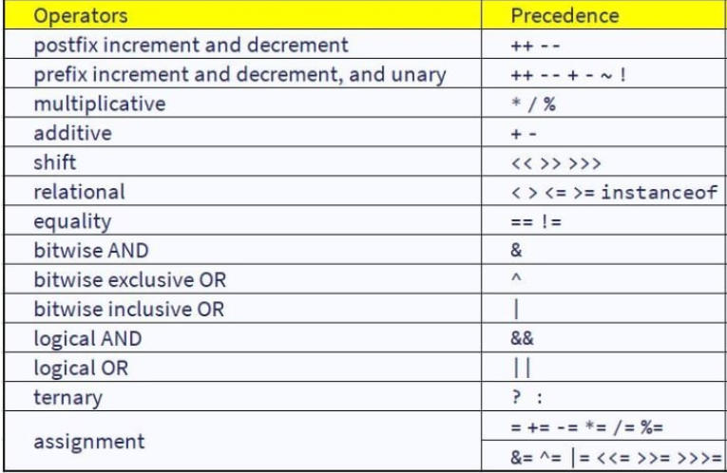

Slide 8
2. Associativity
It determines the direction in which operators of the same precedence level are evaluated.
Operators can have either left-to-right (left-associative) or right-to-left (right-associative) associativity.
Types of Associativity:
Left-to-Right: Most operators (like +, -, *, /, etc.) are left-associative, meaning they are evaluated from left to right.
Right-to-Left: Operators like assignment (=, +=, etc.) and the ternary operator (? :) are right-associative, meaning they are evaluated from right to left.

Slide 9
Example:
int result = 10 + 5 * 3 - 2;
// result is 23
Multiplication (*) has higher precedence than addition (+) and subtraction (-), so 5 * 3 is evaluated first.
The expression becomes 10 + 15 - 2.
Since + and - have the same precedence and are left-associative, the expression is evaluated from left to right: (10 + 15) - 2 = 23.

Slide 10
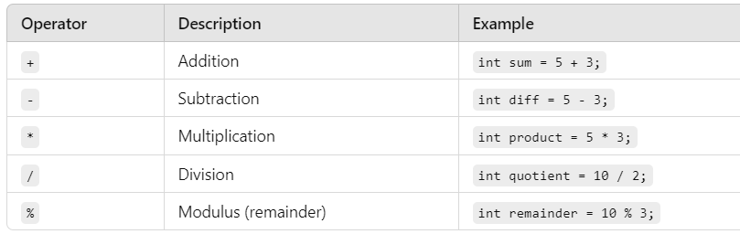
JAVA OPERATORS
Java operators are special symbols that perform operations on variables and values.
They can be classified into several categories based on their functionality.
1. Arithmetic Operators
These operators are used to perform basic mathematical operations.

Slide 11
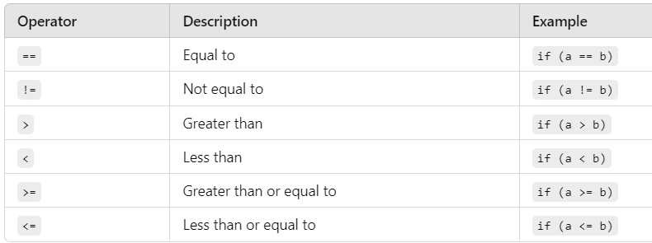
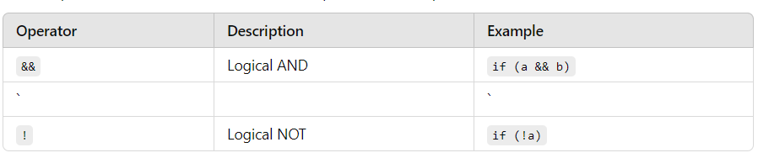
2. Relational Operators
These operators are used to compare two values.
3. Logical Operators
These operators are used to combine multiple boolean expressions.
Logical OR
if (a || b)

Slide 12
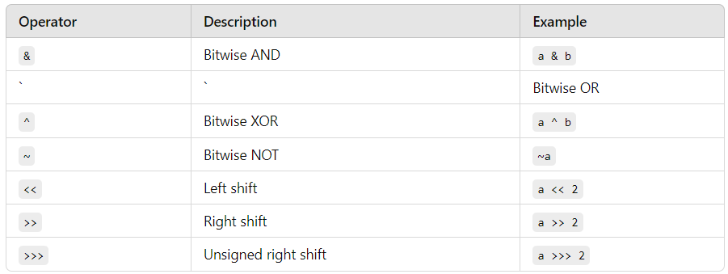

4. Bitwise Operators
These operators perform operations on bits.
a | b
5. Ternary Operator (Conditional Operator)
This operator is used for conditional expressions.

Slide 13
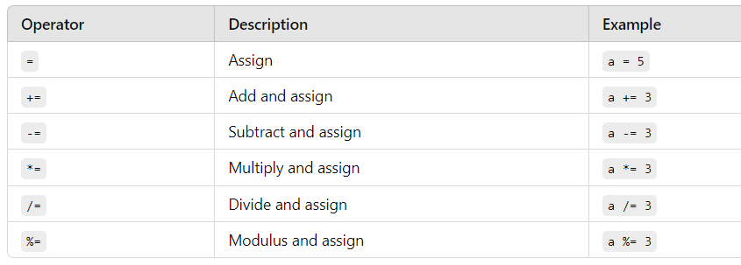
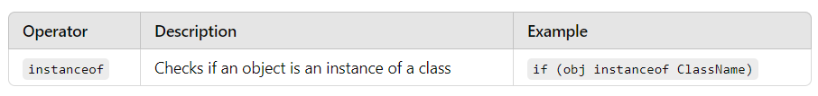
6. Assignment Operators
These operators are used to assign values to variables.
7. Instanceof Operator
This operator is used to test whether an object is an instance of a specific class or subclass.

Slide 14
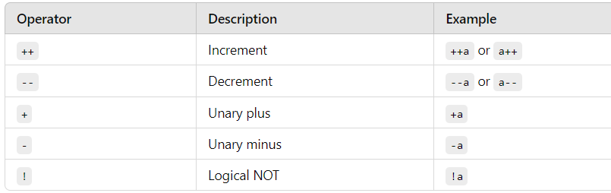
8. Unary Operators
These operators operate on a single operand.

